Slide 1
Welcome…

Slide 2
Project Participants
1-Rasika Sawale
2-Abhijit Shejal
3-Sunil Bhagwat
4-Tarun Borkar
5-Yogesh Jamdade

Slide 3
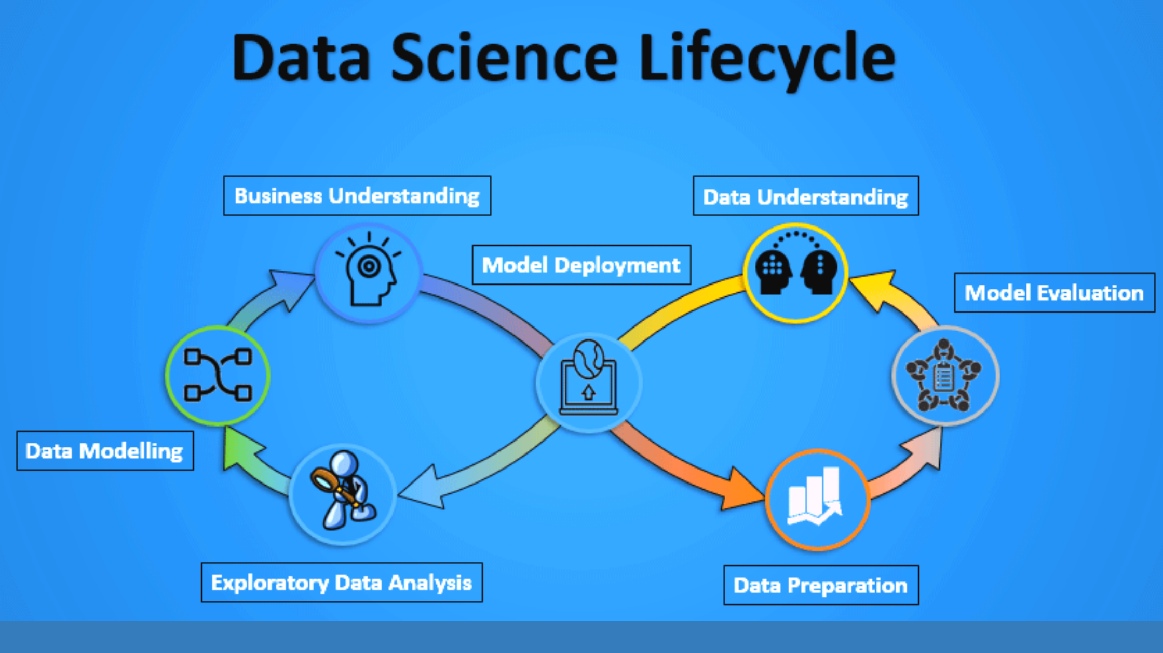
Life Cycle Of Data Science Project

Slide 4
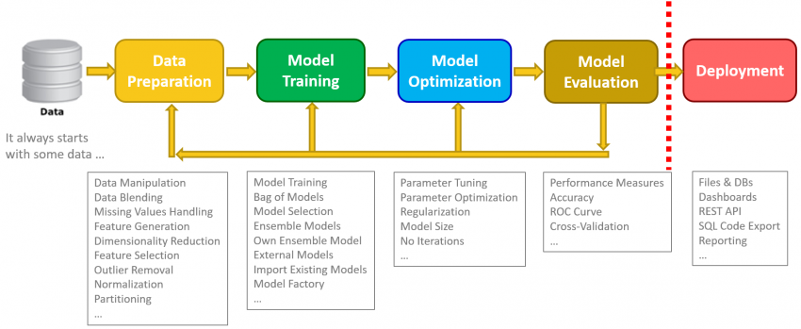
Data SCIENCE PROCESS

Slide 5
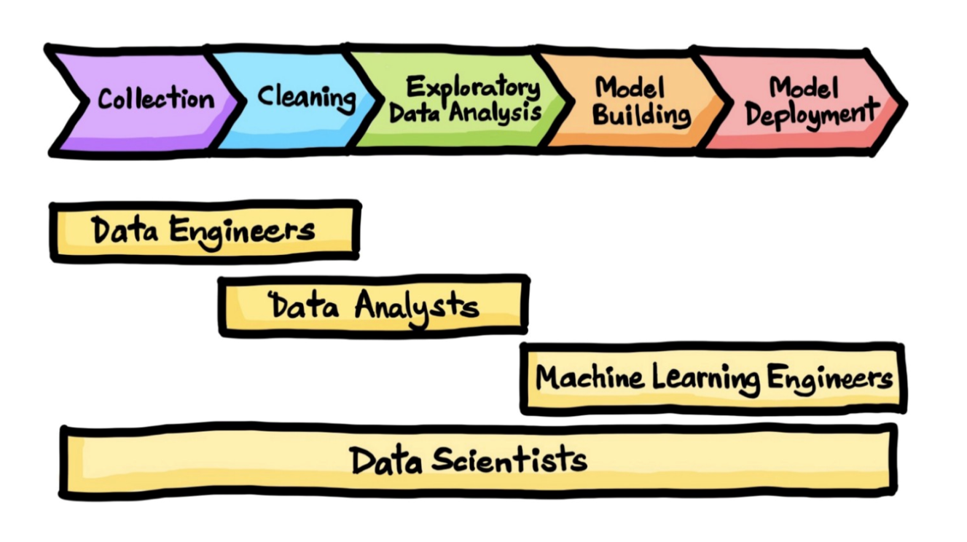
STEPS OF DATA SCIENCE PROJECT
Problem statement
Data Gathering
Exploratory Data Analysis (EDA)
Feature Engineering
Feature Selection
Model Training
Model Evaluation
Web Deployment Framework
Deployment (Deployment on cloud)

Slide 6
1. Problem statement
Create a model that predicts whether a customer was Satisfied or Unsatisfied with the product and/or service which a super market provided.

Slide 7
2. Data gathering
Data gathering is the process of data collection, measuring, and analyzing accurate data from a variety of relevant sources to find answers to research problems, answer questions, evaluate outcomes, and forecast trends and probabilities.
We Gathering Data by using Databases
My Sql
Client database (SQL)
Row ---> 1.5 millions
Column ---> 54 column ~ After feature selection we are having 21 column

Slide 8
3. Exploratory Data Analysis (EDA)
EDA is the process of cleaning and converting raw data into a useable format. It is the process of cleaning the data, selecting the variable to use, and transforming the data in a proper format to make it more suitable for analysis in the next step. It is one of the most important steps of the complete process. Cleaning of data is required to address the quality issues.
Data Cleaning. Data cleaning refers to the process of removing unwanted variables and values from your dataset and getting rid of any irregularities in it.
Missing Values
Duplicate data
Invalid data

Slide 9
4. Feature engineering
Feature Engineering is one of the most crucial tasks and plays a major role in determining the outcome of a model.
Feature Engineering encapsulates various data engineering techniques such as following:-
Scaling :-
Type of scaling:-
Standardization / Normalization : ( Unit Price , Quantity , Tax , Total Price , Cost of good sold , Gross Income )
2. Encoding
One Hot Encoding ( Branch , City , Product line , Payment )
Label Encoding : (Gender , Customer Type )
3.Binning : ( Rating )

Slide 10
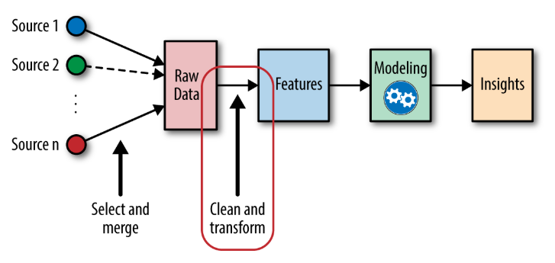

Slide 11
5. Feature selection
Feature Selection is the method of reducing the input variable to your model by using only relevant data .
It is the process of automatically choosing relevant features for your machine learning model based on the type of problem you are trying to solve.
Methods of Feature Selection
Filter Method : ( Chi-Square test , ANNOVA test )
Wrapper Method : ( Exhaustive , Bi-directional ,Recursive)
Embedded Method : ( Random Forest / Decision Tree Feature Importance )

Slide 12
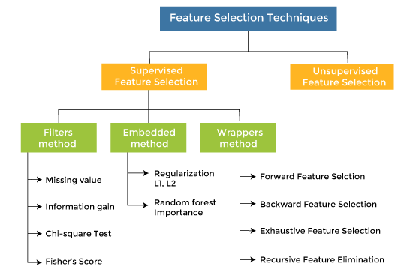

Slide 13
6. Model training
Now the next step is to train the model, in this step we train our model to improve its performance for better outcome of the problem.
We use datasets to train the model using various machine learning algorithms. Training a model is required so that it can understand the various patterns, rules, and, features.
Model training is the phase in the data science development lifecycle where practitioners try to fit the best combination of weights and bias to a machine learning algorithm to minimize a loss function over the prediction range.
We must select an ML model that is most suitable for the project in order to train the best performing model feasible utilising the pre-processed data.
In supervised learning, an AI system is supplied with data that has been labelled, meaning that each piece of information has been assigned to the appropriate label. "Classification" and "Regression" are two more categories in which supervised learning is classified.

Slide 14
Some of the most often used categorization ml algorithms are listed below.
K-Nearest Neighbor
Naive Bayes
Decision Trees
Random Forest:- (90%)
Support Vector Machine
Logistic Regression

Slide 15
Test Model
Once our machine learning model has been trained on a given dataset, then we test the model. In this step, we check for the accuracy of our model by providing a test dataset to it.
Testing the model determines the percentage accuracy of the model as per the requirement of project or problem.

Slide 16
three sections:
Training set:
The training set is the material that the computer uses to learn how to analyse data. The training component of machine learning is done through algorithms. A set of data is used for learning or fitting the classifier's parameters.
Validation set:
Cross-validation is most commonly used in applied machine learning to evaluate a machine learning model's competence on unknown data. To fine-tune the parameters of a classifier, unseen data is extracted from the training data.
Test set:
Unseen data is only used to evaluate the performance of a fully described classifier. We may begin the training procedure after the data has been separated into three pieces.

Slide 17
7. Model Evaluation
Model evaluation is an important step in the creation of a model. It aids in the selection of the best model to represent our data and the prediction of how well the chosen model will perform in the future.
For Clasification :-
We use the following metrics for model evaluation
Confussion Metrics
Classification report ( Accuracy, Precision, Recall,F-beta-score)
AUC (Area under curve) and ROC (receiver operating characteristic curve)
Accuracy
Precision
Recall
F-beta-score

Slide 18
8. web development framework
A web development framework is a set of resources and tools for software developers to build and manage web applications, web services and websites.
Such a framework includes templating capabilities for presenting information within a browser, the programming environment for scripting the flow of information and the application programming interfaces (APIs) for accessing underlying data resources.
Fask API (Application Programming Interface)

Slide 19
Web DeploymenT
Web deployment on AWS server.

Slide 20
Thank you!!!!!!...

